Slide 1
Understanding Clouds from Satellite Images
CSC 591 Neural Networks
Team 125
Srilekha Gudipati(sngudipa)
Aditi Vakeel(avakeel)
Sai Krishna Teja Varma Manthena(smanthe)

Slide 2
Problem Statement
Use Deep Learning to analyze, detect and segment cloud formation in satellite images from MODIS and GOES-16 satellites.
Predict the boundaries of each cloud and segment into:
FISH
FLOWER
GRAVEL
SUGAR
Motivation: Cloud formation helps understand the climate system and weather patterns.
Notes:
This is an image segmentation problem as one image can have all four patterns of clouds as well.

Slide 3
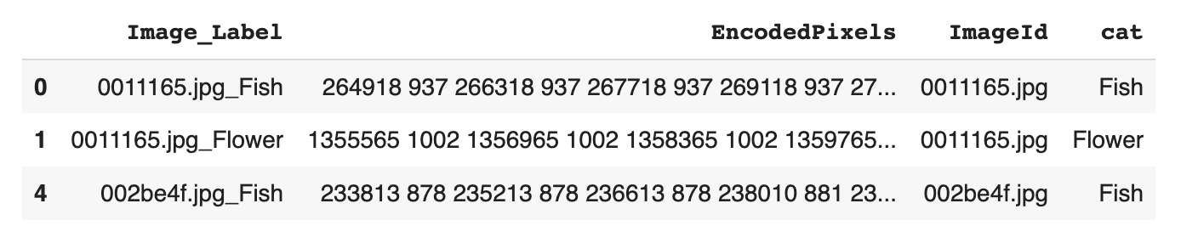
Dataset
Cloud forms can be seen on satellite pictures with the labels "Fish," "Flower," "Gravel," and "Sugar."
5546 images.
An image may be combined from two orbits due to the imager's (MODIS) modest footprint on board these satellites.
Even if an image has multiple non-contiguous sections of the same cloud formation, the segment for each cloud formation label is encoded into a single row. For an image, the relevant ‘EncodedPixels’ prediction should be left blank if there is no area of a certain cloud type.

Slide 4
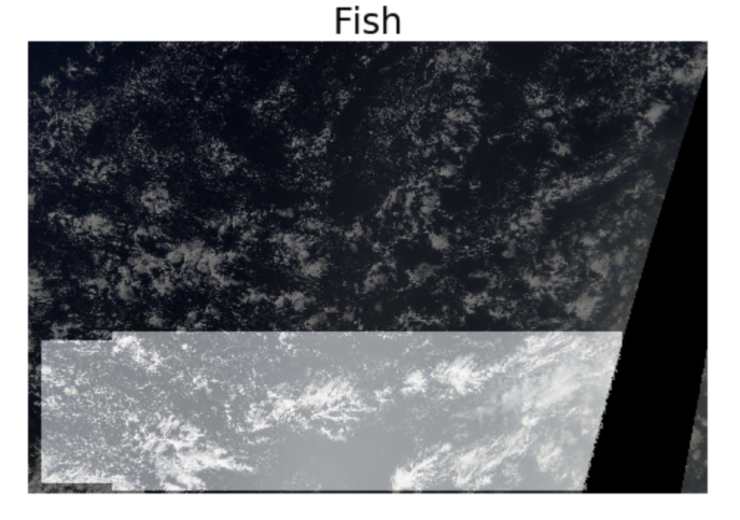
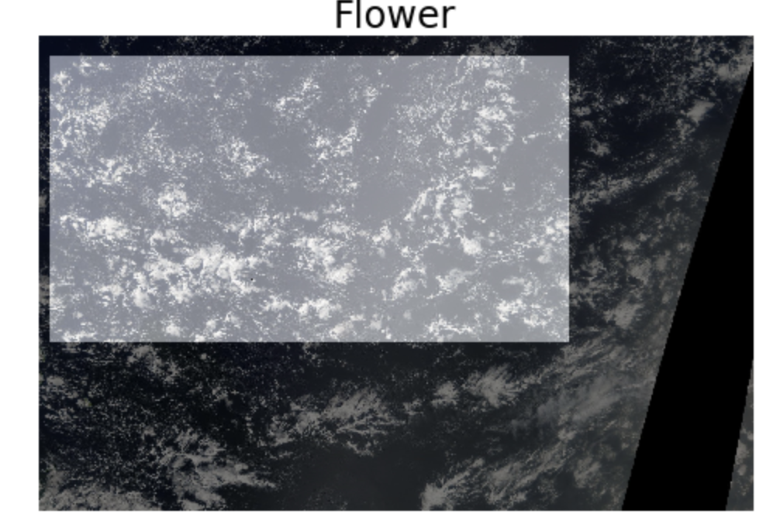
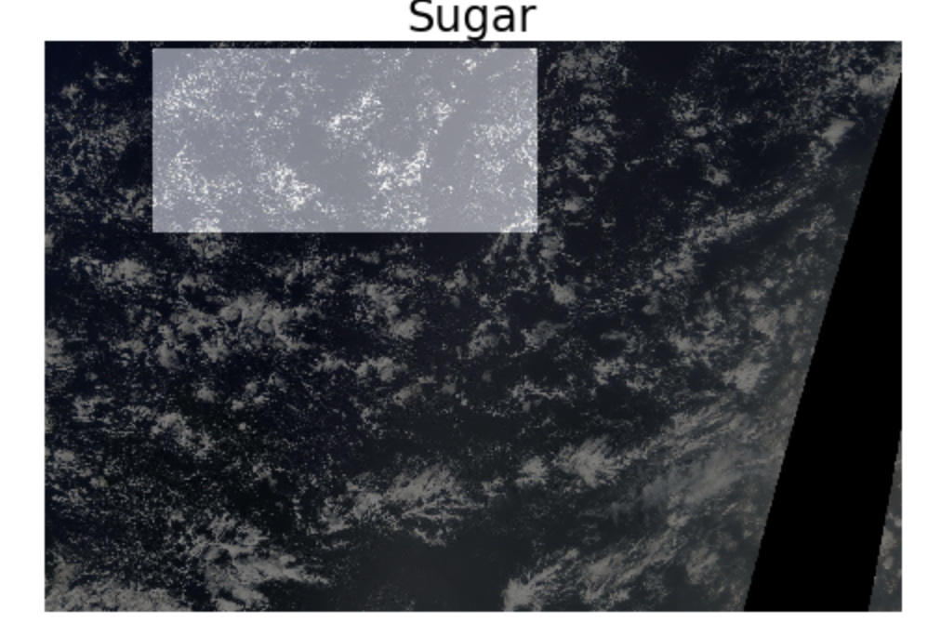
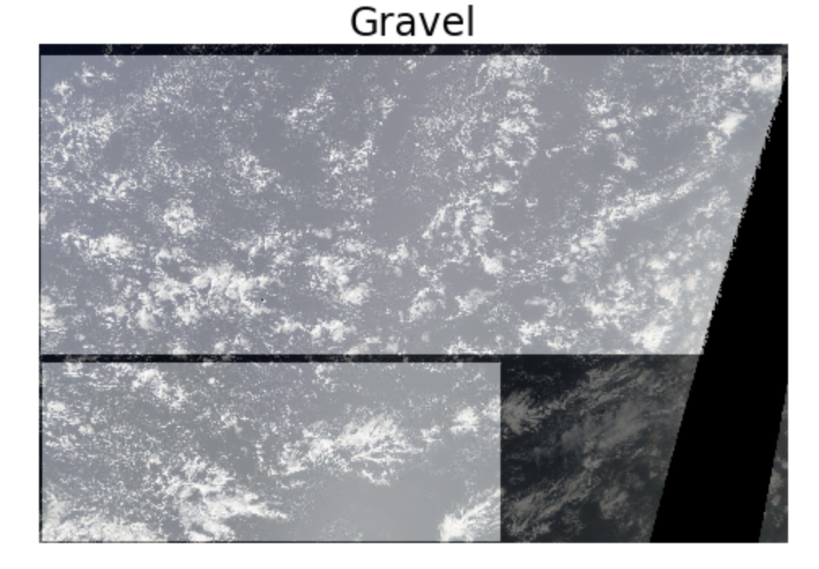
Notes:
We use a concept called masking. A mask is basically a binary image consisting of zero or non-zero values that is used to highlight a part of the image. These masks are used to obtain the desired result required for the segmentation task. We can see that masks can overlap and that masks are often quite big and can have seemingly empty areas.

Slide 5
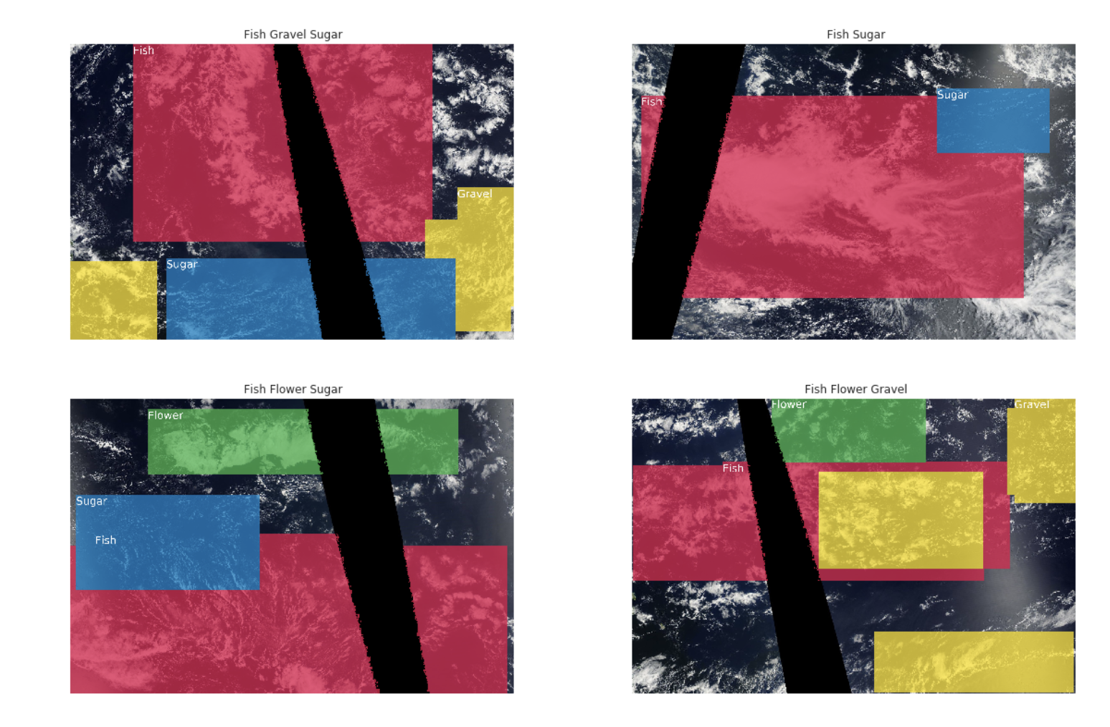
Notes:
https://www.kaggle.com/code/aleksandradeis/understanding-clouds-eda
I will use imgaug library to visualize the segmentation maps. This library has special helpers for visualization and augmentation of images with segmentation maps.

Slide 6
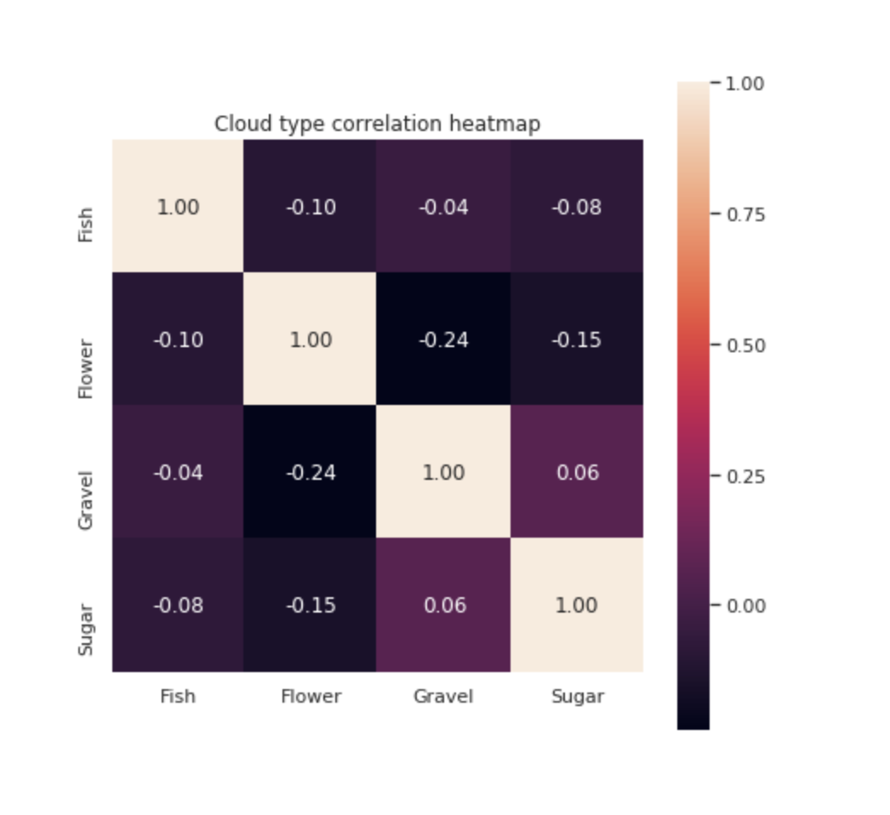
Notes:
A correlation heatmap that shows if the presence of one type of pattern is directly related to presence of another type and we see a negative relationship between the different masks. This strengthens the fact that each type of cloud will definitely give different data on a geoscience basis

Slide 7
Baseline Model
UNet ,commonly used for semantic segmentation, where the goal is to classify each pixel of the image into different categories.
ResNet-34 is used which consists of several blocks of convolutional layers, each of which is followed by a batch normalization layer and a ‘sigmoid’ activation function.
Notes:
UNet with ResNet34 is a type of neural network architecture that combines the features of two popular models: the UNet and the ResNet34.
The UNet is a convolutional neural network (CNN) that is widely used for image segmentation tasks. It is composed of a contracting path that captures the context of the input image and an expanding path that produces a segmentation map with pixel-wise predictions.
On the other hand, ResNet34 is a CNN that is known for its ability to train very deep networks by using residual connections. These connections allow the network to skip over some layers during the forward pass, which helps to mitigate the vanishing gradient problem.
By combining these two architectures, UNet with ResNet34 can achieve better performance on image segmentation tasks, especially when dealing with large and complex images. The ResNet34 component provides the depth needed for capturing high-level features, while the UNet component enables precise segmentation of objects and regions.
### for future ref
Assuming that model is a neural network model for image segmentation, calling model.predict() on a batch of input images would generate predicted masks for each input image in the batch.
The val_generator is a data generator that yields batches of validation data (input images and their corresponding target masks) to the model. For each batch, the model.predict() method is called on the input images to generate predicted masks. These predicted masks are then compared to the corresponding target masks using a loss function specified when compiling the model.
The loss function compares the predicted masks to the target masks and calculates a scalar value that measures the difference between them. During training, the model tries to minimize this loss value by adjusting its weights and biases. By comparing the predicted masks to the target masks in this way, the model can learn to segment the input images accurately.

Slide 8
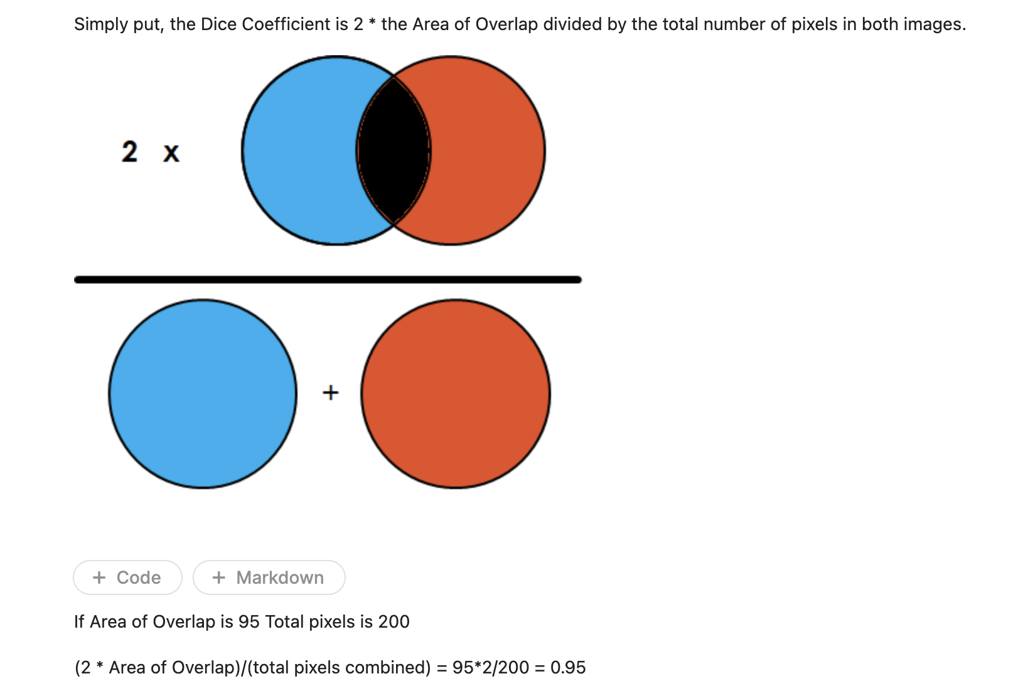
Accuracy measure - dice coefficient

Slide 9
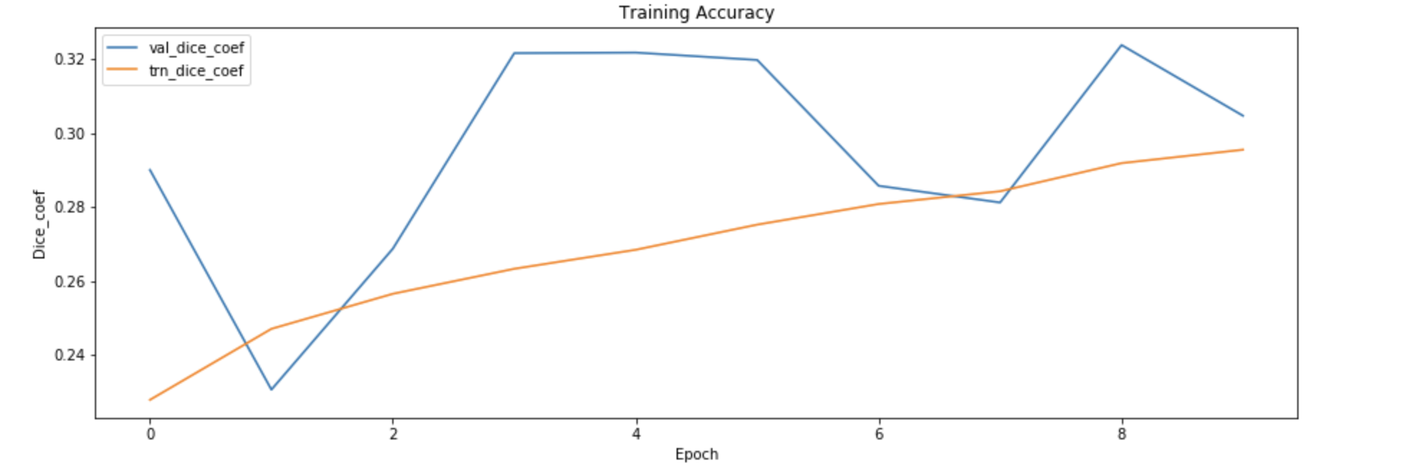
Performance of Baseline Model
Notes:
10 epochs ki 46%
loss: 2.7442 - dice_coef: 0.6134 for efficient net
The graph between validation Dice coefficient and Dice coefficient is a common way to visualize the accuracy of an image segmentation model. The Dice coefficient is defined as twice the intersection of the predicted and ground truth masks divided by the sum of the predicted and ground truth masks.
In a graph of Dice coefficient versus validation Dice coefficient, if the segmentation model is accurate, we would expect to see a strong positive correlation between the Dice coefficient and validation Dice coefficient, which is evident from the curve seen in the slides.
We have used a bce_dice_loss function. The binary-crossentropy - dice loss is a commonly used loss function in image segmentation tasks that combines the BCE loss and the Dice loss to evaluate the similarity between the predicted segmentation mask and the ground truth mask. The lower the loss value, the better the model predicts, and we can see this falls down below 0.5 after 3 epochs itself and is negligible thereafter.
10 epochs ki 65%
The graph between validation Dice coefficient and Dice coefficient is a common way to visualize the accuracy of an image segmentation model. The Dice coefficient is a commonly used evaluation metric for measuring the performance of segmentation models, and it is defined as twice the intersection of the predicted and ground truth masks divided by the sum of the predicted and ground truth masks.
In a graph of Dice coefficient versus validation Dice coefficient, the Dice coefficient is typically plotted on the x-axis and the validation Dice coefficient is plotted on the y-axis. Each point on the graph represents the performance of the segmentation model on a particular image or a group of images.
If the segmentation model is accurate, we would expect to see a strong positive correlation between the Dice coefficient and validation Dice coefficient. This means that when the model performs well on a particular image, it also performs well on the validation set.
Conversely, if the model is not accurate, we would expect to see a weak or negative correlation between the Dice coefficient and validation Dice coefficient. This means that the model may perform well on some images but poorly on others.
In summary, the graph between validation Dice coefficient and Dice coefficient provides a visual representation of how well an image segmentation model is performing on both the training and validation sets. A strong positive correlation between these two metrics indicates that the model is accurate, while a weak or negative correlation suggests that the model may need further improvement.

Slide 10
Improvements done
Using Efficient Net architecture.
Image augmentation using albumentations.
Fine tuning hyperparameters using the dice loss values after each epoch.
Using PR AUC(precision recall area under curve) callback to determine how many epochs to train.
Notes:
Efficient net, stratified sampling for training,
Images - 4 masks - 260 images ;
PR-AUC-based Callback
The callback would be used:
to estimate AUC under precision recall curve for each class,
to early stop after 5 epochs of no improvement in mean PR AUC,
save a model with the best PR AUC in validation,
to reduce learning rate on PR AUC plateau.
before:
Explore Efficient Net and other such architectures(Mask R-CNN, U-Net++, and HRNet) to see which one works better.
Image augmentation
Fine tuning hyperparameters using the dice loss values after each epoch
Using PR AUC(precision recall area under curve) callback to determine how many epochs to train.

Slide 11
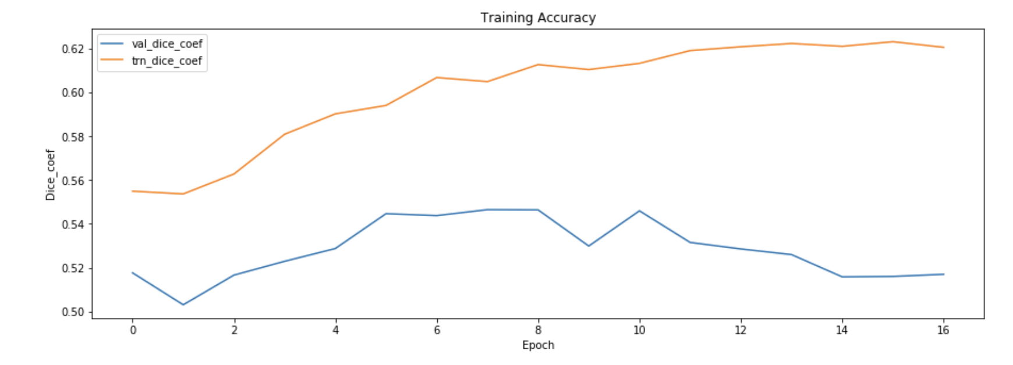
Accuracy with Efficient net
The accuracy rose from 45% -> 65% with efficientnet and augmentations
Notes:
PR AUC Fish, val: 0.577
PR AUC Flower, val: 0.598
PR AUC Sugar, val: 0.774
PR AUC Gravel, val: 0.626
PR AUC mean, val: 0.644

Slide 12
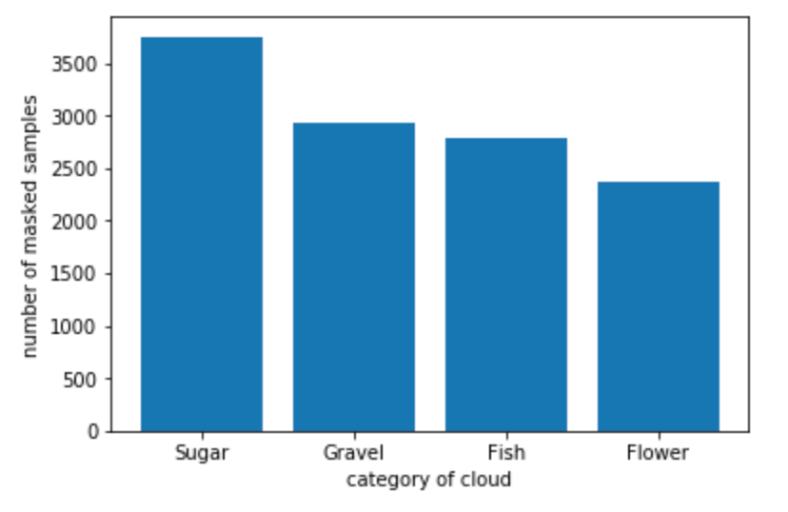
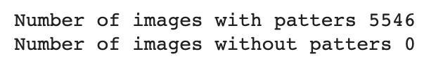
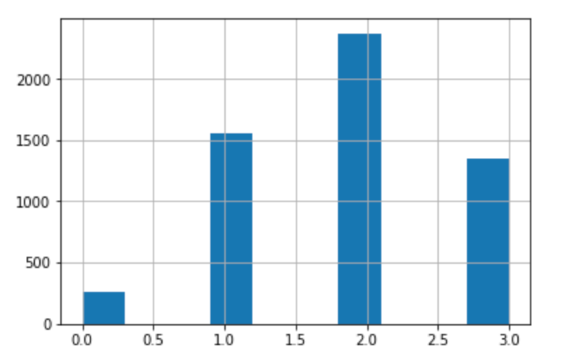
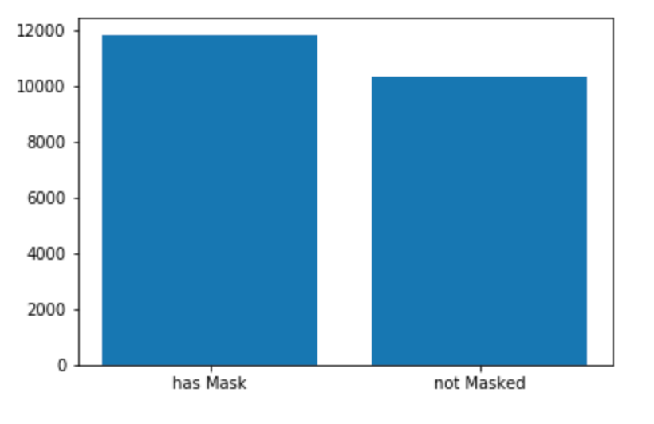
Challenges encountered
Notes:
used stratified sampling during training to handle labels imbalance.
Visualizations
New architectures

